Slide 1
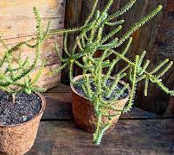
Youlk
Ravensthorpe radish
By Archie and Riley

Slide 2
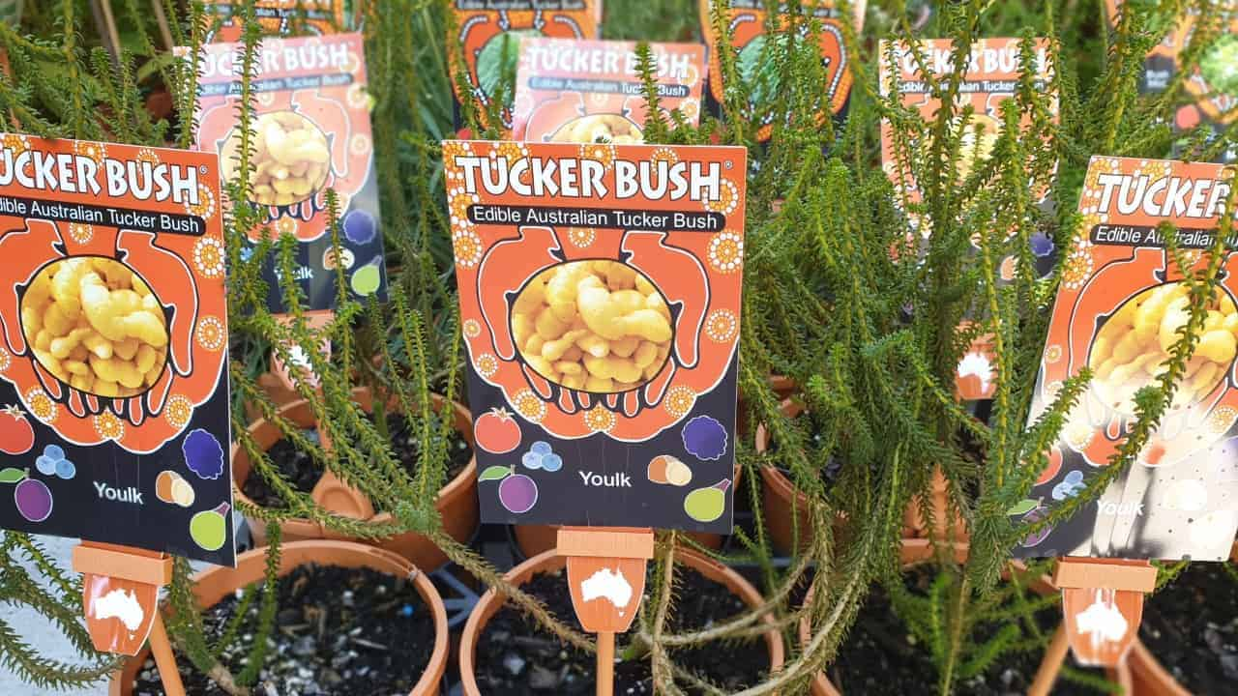
About
Carrot like with a sweet eucalypt flavour
Attracts bees and insects
Height 0.4m
Width 1m
Suitable for gaps
Suitable for pots
Suitable for full-sun

Slide 3
Recipe: A journey through Australian native food Link
Ingredients
400 g macadamia nuts
250 ml filtered water
1 tsp lemon myrtle oil
1 small youlk or white radish
500 ml grape seed or vegetable oil for frying
2 bunches sea celery (or parsley)
4 tsp lemon myrtle emulsion

Slide 4
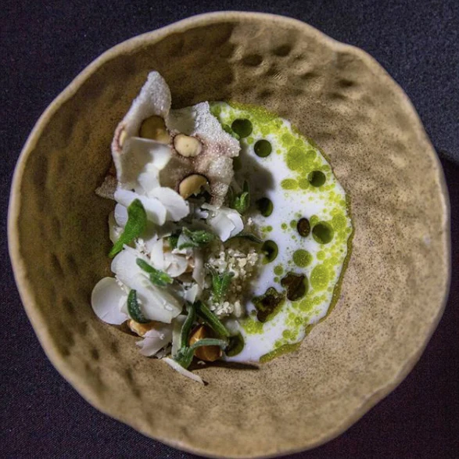
Recipe: A journey through Australian native food
Method
Pre-heat oven to 180 Degrees Celsius.
Chop 50 g of macadamia nuts and roast in the oven for 6-8 minutes or until just golden brown. Set aside.
In a food processor, pulse 200g of the macadamia nuts until they’re the consistency of couscous. don’t over puree or the nuts as they will turn to a paste. Set aside.
Using a jug blender, process 120g of the macadamia nuts with the water for two minutes to form a macadamia nut milk.
Strain macadamia nut milk through a muslin cloth or alternative into a bowl or pot. Add the lemon myrtle oil. Set aside.
On a mandolin, carefully shave the remaining macadamia nuts into paper thin slices. Set aside.
Shave the youlk into paper thin slices on a mandolin and set aside.
In a medium pot, heat oil to 200 degrees Celsius.
Pick sea celery into 10 cm long stalks and fry. Once it has stopped bubbling, remove from oil and place on paper towel to drain.
To serve, place one teaspoon of lemon myrtle emulsion onto each plate.
Cover with a quarter of the macadamia nut couscous. Add one tbsp of roasted macadamia nuts. Now add the shaved youlk and shaved macadamia nuts. Place sea celery stalks on top. Finish with 2 tbsp of the macadamia nut milk.
prep/cook: 40 minutes | serves: 4 as an entrée

