Slide 1
Warringal greens
By Alister

Slide 2
AKA Native Spinach

Slide 3
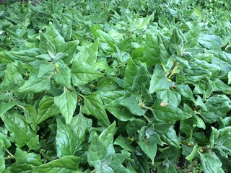
Must be cooked

Slide 4
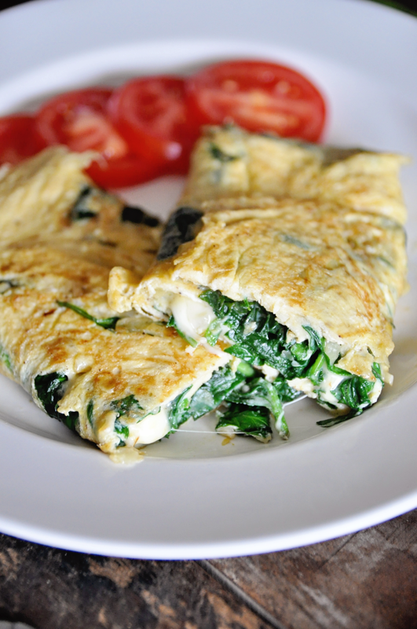
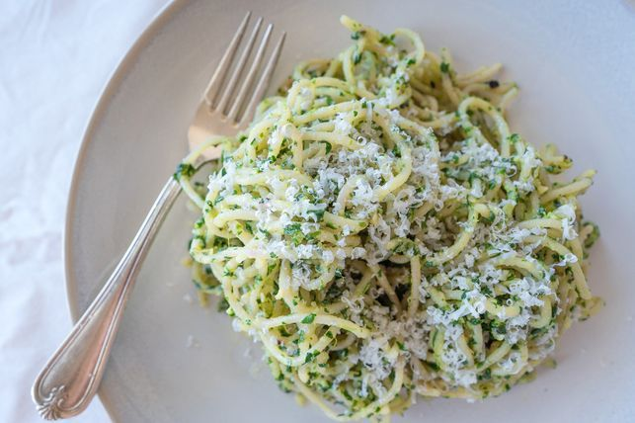
Use them in pesto and omelettes

Slide 5
Ingredients for Pan fried Pink Snapper, Native lemon grass reduction, Vegetable puree, sautéed sea parsley and warrigal greens
Method
Season and dry snapper fillets, then fry skin side down in hot olive oil for two minutes. Apply pressure to avoid shrinkage, turn and cook two more minutes. Add squeeze of lemon and 1 tbsp butter to pan and baste. Transfer pan to oven on low heat to keep warm.
Squeeze juice of one lemons and combine with 10 lemongrass strands, snapper bones, onion, celery and water to cover. Bring to boil, simmer 15 minutes, skimming. Remove bones, and strain, then return to pan and reduce further with addition of more native lemongrass to taste. Season. Once reduced by half and strained again, gently add cold cubes of butter, whisking to emulsify over medium heat until thickened.
Take two handfuls of warrigal greens, bash with a rolling pin and boil quickly for two minutes to remove oxalic acid. Strain and squeeze out excess water. Pick fresh sea parsley on stems, blanch in hot water for 15 seconds (still want to retain crunch), then refresh in iced water. Remove and dry off leaves, season with salt and pepper then saute in hot butter with warrigal greens.
Scrape vegetable puree, such as turnip, potato or pea puree onto plate, top with warrigal greens then warm snapper fillet, crispy skin side up. Drizzle with native lemongrass emulsion and garnish with sautéed sea parsley.
Serves 2
350g Snapper fillets, skin on, scaled (reserved snapper bones) 100g Warrigal greens 200ml of selected vegetable puree 150g cold butter, cubed 2 sticks of celery Half Onion, rough chopped 3 lemons 20 springs of dried Native lemongrass 3 sprigs of Sea Parsley Salt and pepper Olive oil
https://tuckerbush.com.au/pan-fried-pink-snapper-native-lemon-grass-reduction-vegetable-puree-sauteed-sea-parsley-and-warrigal-greens/

