Slide 1
Sea celery
Apium Prostratum vent.
By Theodore, Bodhi

Slide 2
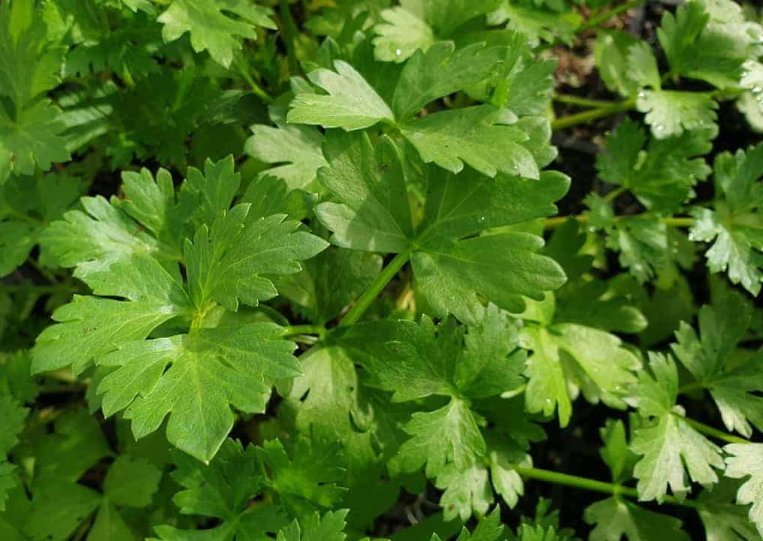
About
Sea celery needs the sea to grow.
Sea celery is edible.
Sea celery can grow up to 1 meter in height.
Sea celery grows in South Australia, Victoria, Tasmania, New South Wales and Southern Queensland.

Slide 3
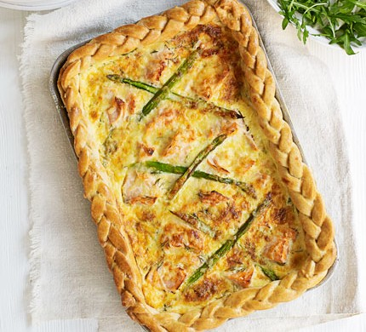
Smoked Salmon and Sea Parsley Quiche
Ingredients
1 extra large sheet frozen shortcrust pastry.
6 eggs.
300 ml cream.
2 cups grated low-fat tasty cheese
100gm Smoked Salmon, cut into strips
2 tsp Sea Parsley
Tropical Pepperberry Sea Salt to taste

Slide 4
Smoked Salmon and Sea Parsley Quiche
Method
Preheat oven to 230 degrees. Allow pastry sheet to thaw and then press into the quiche pan. Trim any overhanging edges. Prick the pastry evenly all over with a fork, place foil in the pan and weigh down with pastry weights or uncooked rice. Blind bake in a hot oven for approximately 10 minutes. Remove from oven and allow to cool.
In a bowl, whisk together the eggs, cream, Sea Parsley and artesian salt and mountain pepper. Add 1 cup of the grated cheese and stir to combine. Stir in the smoked salmon strips.
Remove the foil and rice / weights from the quiche base and pour in the egg mixture. Make sure the ingredients (here, the salmon strips) are evenly spread around the quiche.
Sprinkle the remaining cup of grated cheese over the top of the quiche. You may also wish to add some grated parmesan or other variety of cheese to add extra flavour.
Bake in a 180 degrees oven for 35 minutes, until a skewer inserted into the centre comes out clean. Serve alongside salad or as part of a picnic lunch.

Slide 5
Swaggies Cannelloni
Ingredients
1 packet Cannelloni Tubes
1 tin whole tomatoes
500gm pork mince
2 tablespoons Macadamia Nut Oil
1 tablespoon Swagman Salt
2 garlic cloves minced
4 slices toasted bread torn into pieces
Grated Cheese
Milk
2 tablespoons Butter
2 tablesoons plain flour
1 teaspoon lemon myrtle
1 Handful of sea celery

Slide 6
Swaggies Cannelloni
METHOD
Meat filling
Mix pork mince, 1 tablespoon Macadamia Nut Oil and sea parsley together and place in fridge for 4 hours.
Place the remaining Macadamia Nut Oil in a pan with the pork mixture and the garlic. Brown and then add the tin of tomatoes. Simmer for 15 minutes before adding the toasted bread. Mix well and allow to cool.
White Sauce
Melt the butter in a pan and then add the flour and lemon myrtle. It will become quite gluey. Allow to cook for a couple of minutes before adding the milk a little at a time until a smooth sauce develops. Amount of milk will depend on how much it takes to get a sauce that is thick and not too runny
To assemble
Grease a baking dish and place a layer of white sauce on the bottom.
Now spoon the meat filling into each cannelloni tube and place each filled tube onto the white sauce bed. When the white sauce bed is covered with filled tubes then pour the remaining filling over tubes, top with the remaining white sauce and cover the whole lot liberally with grated cheese. Bake in 180C oven for approx. 30 minutes.

