Slide 1
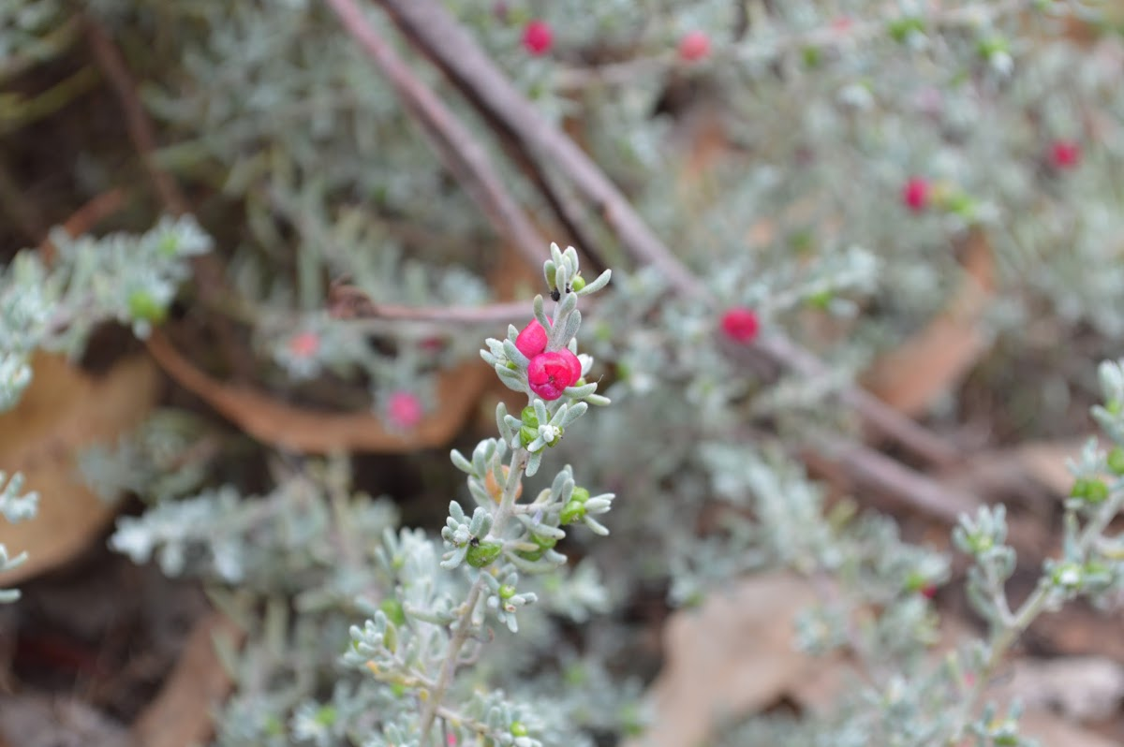
Ruby Saltbush
By Maisyn and Macey.

Slide 2
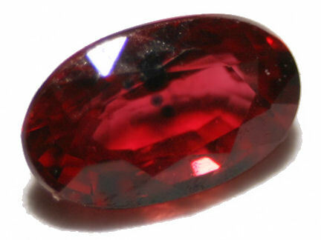
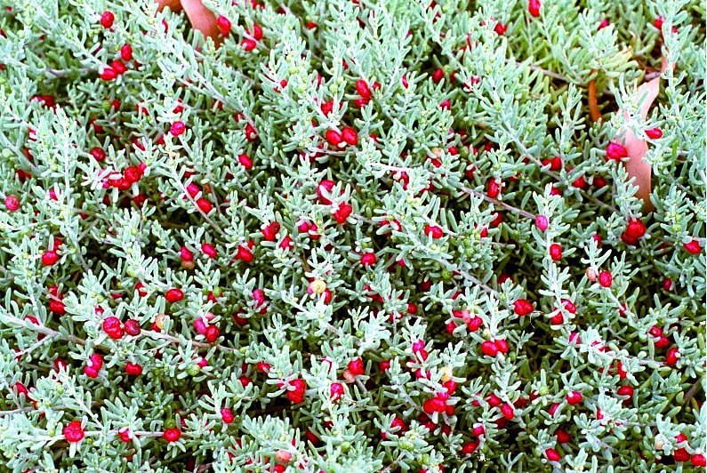
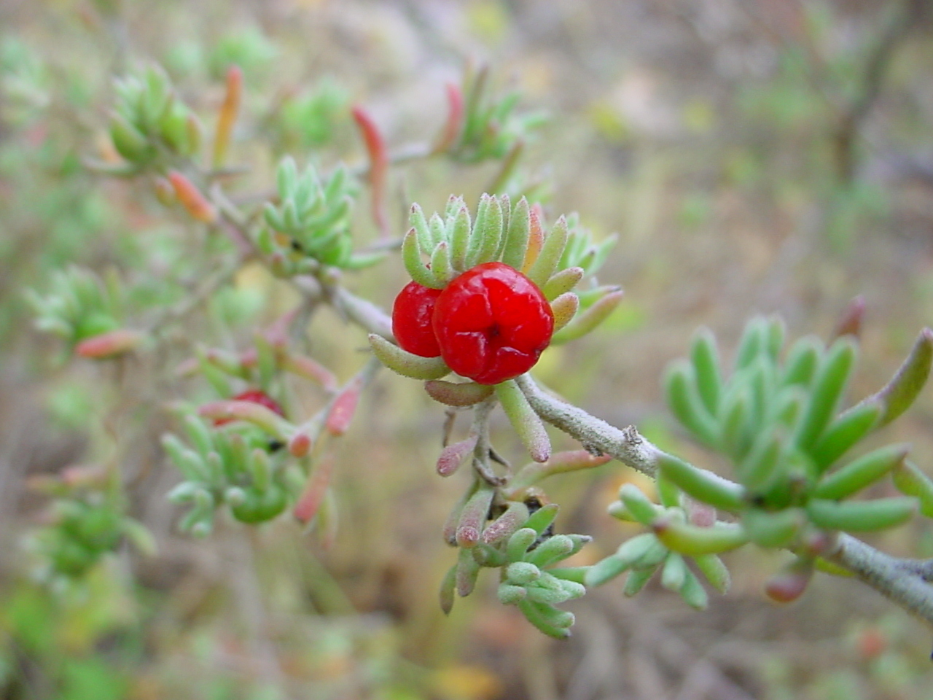
About
Ruby saltbush is a small shrub.
The leaves are small green or grey in colour and in the shape of a tiny sausage.
A ruby saltbush is a member of the world wide Chenopodiaceae family has many common names , among them ruby saltbush and Barrier saltbush.

Slide 3
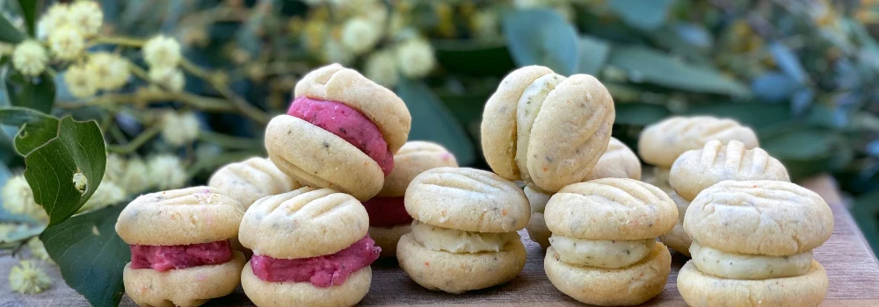
RUBY MELTING MOMENTS
INGREDIENTS
Biscuits
250g unsalted butter, softened
4 TBSP icing sugar
4 TBSP custard powder
1 ½ cup (225g) plain flour
1 TSP kunzea*
* Or you can substitute in lemon myrtle, wattleseed, strawberry gum or aniseed myrtle
Icing
Your choice! Why not try them all!
Raspberry Icing
60g unsalted butter, softened
1 cup icing sugar (135gm)
½ TSP lemon myrtle
8 frozen (or fresh) raspberries (20gm)
Lemon Icing
60g unsalted butter, softened
1 cup icing sugar (135gm)
1 TBSP lemon juice
½ teaspoon lemon myrtle*
* Or strawberry gum, aniseed myrtle, kunzea, wattleseed or pepperberry.

Slide 4
METHOD
Preheat oven to 150°C
Cream butter, icing sugar and kunzea (or other bushfood) until pale & fluffy
In a separate bowl, sift custard powder and flour together
Continue beating butter mixture whilst adding the flour mixture, a couple of tablespoons at a time, until all combined
Roll into 24 balls*
With a fork, press down to flatten tops of the biscuits slightly shape when cooked
Refrigerate the uncooked biscuits for 3-5 minutes, so they hold their
. Spread biscuits out on a baking tray and bake at 150°C for 15-20 minutes until cooked through Remove from oven and let cool for 30 minutes
Make the icing by beating the icing ingredients together until light and fluffy
Add a teaspoon of icing to 12 of the biscuits and then join with the remaining 12
YAY!!!!!

Slide 5
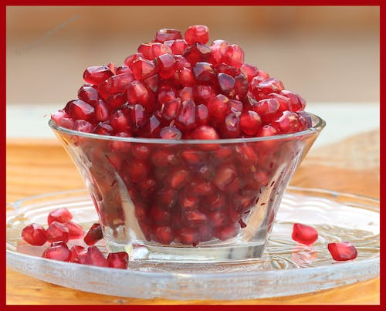
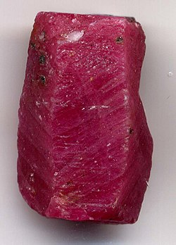
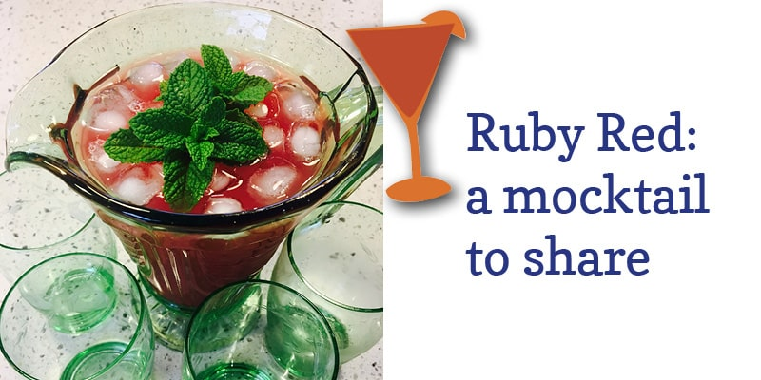
You can put the ruby saltbush berries together then it will make a crystal.
YUM YUM!

Slide 6
By I hope you like it

