Slide 1
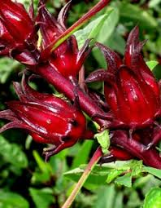
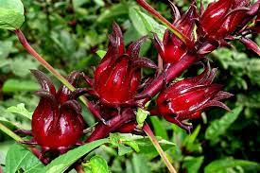
Rosella
By Rosalind and Ella

Slide 2
About rosella
Rosella is a tropical plant.
Rosella is a hardy plant.
Rosella can survive dry spells.
Rosella is frost sensitive and grows as an annual in regions with cold winters.

Slide 3
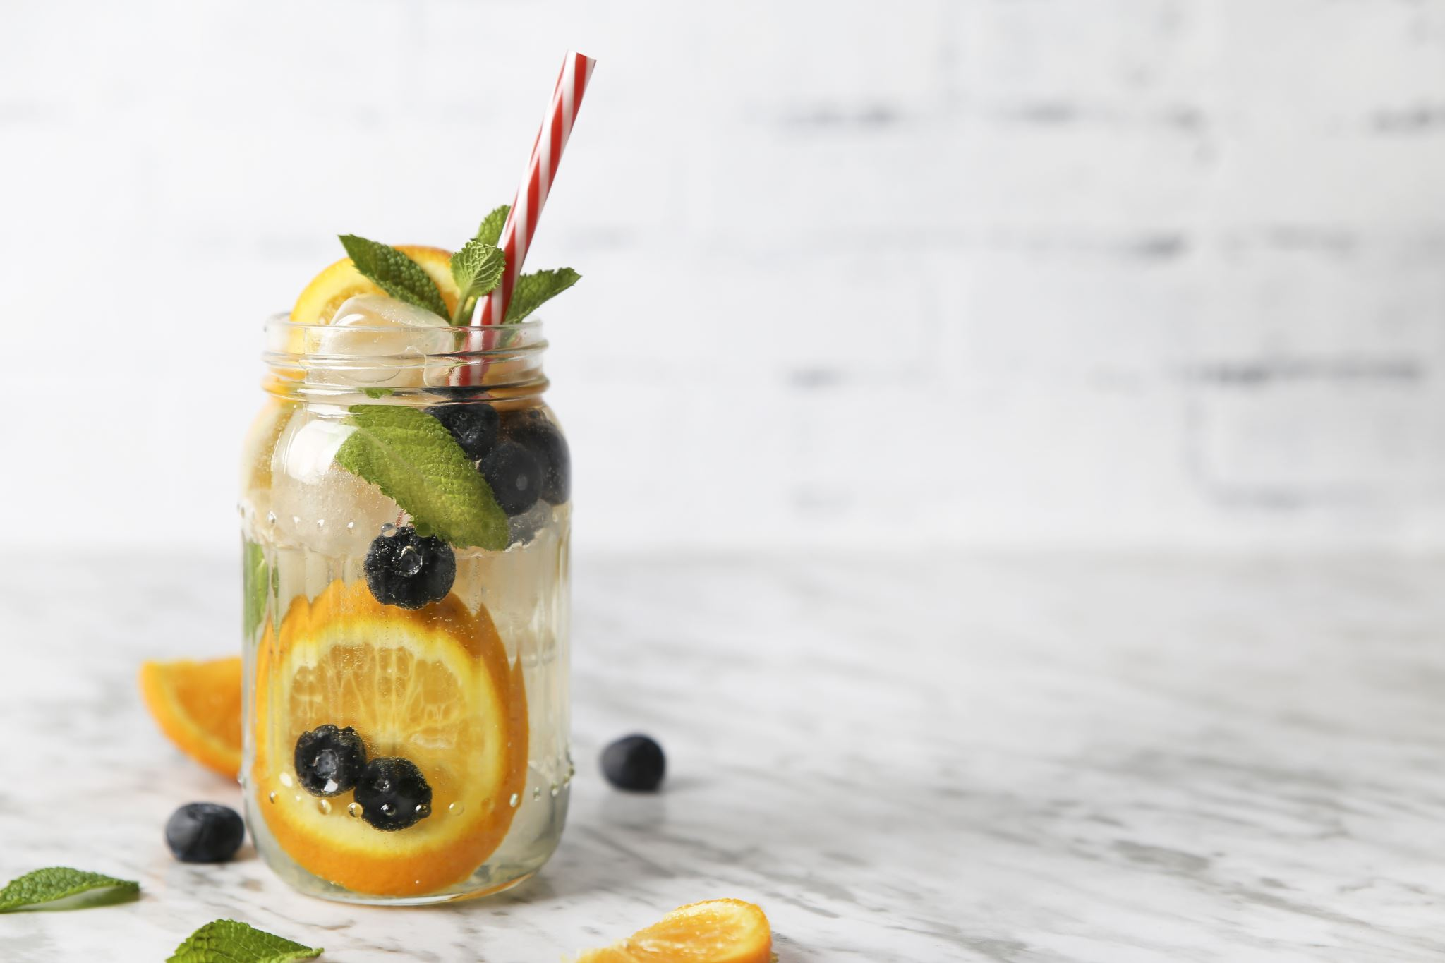
Rosella Jam
Prepare your jars.
Wash jars well with a bottle brush, detergent and warm water.
Dry and warm the jars by placing on a tray in a low oven, heated to around 120 degrees Celsius, for 10 minutes.
Pour boiling water over the lids and drain.
Fill the jars with jam whilst they are still warm.
Ingredients
Rosellas
Sugar
Water
1 teaspoon of butter
The juice of 1 lemon

Slide 4
Rosella Jam
Method
Separate red calyxes from the seedpods
Wash and drain each separately.
In a saucepan, add seeds and water until the seeds are just covered. Tip: (Add a little extra water to the seeds, at this stage, if necessary, rather than adding extra later)
Bring to boil and cook covered, for 30 minutes.
Strain and reserve the juice in a second saucepan. The seeds can now be discarded.
To this juice, add the red calyxes which have been thoroughly washed and drained. The calyxes may not be completely covered with juice, but they will boil down very quickly.
Boil for 20 minutes until a 'pulp' is formed
Measure the volume of cooked pulp and return to pan. (measurement is needed for step 10)
Add one good teaspoon of butter, and the juice of one lemon.
Add an equal amount of warmed sugar to pulp. For example, add 1 cup of sugar to each cup of pulp, stirring well till all the sugar is completely dissolved. (pre-warm sugar on a heat proof tray, in a oven on low heat)
Boil quickly uncovered for 20 minutes or until jam falls thickly from a spoon when tested.
lyxes from the seedpods
Wash and drain
Fill jars with jam while the jars and jam are still warm. Allow to cool a little and then seal.

