Slide 1
Native Thyme
Tom and thomas

Slide 2
Health benefits
Thyme is particularly rich in vitamin A and vitamin C. Vitamin A is an antioxidant known for being vital in maintaining healthy mucus membranes and skin as well as good vision. Vitamin C is essential to resist infectious diseases and protects against harmful pro-inflammatory free radicals.

Slide 3
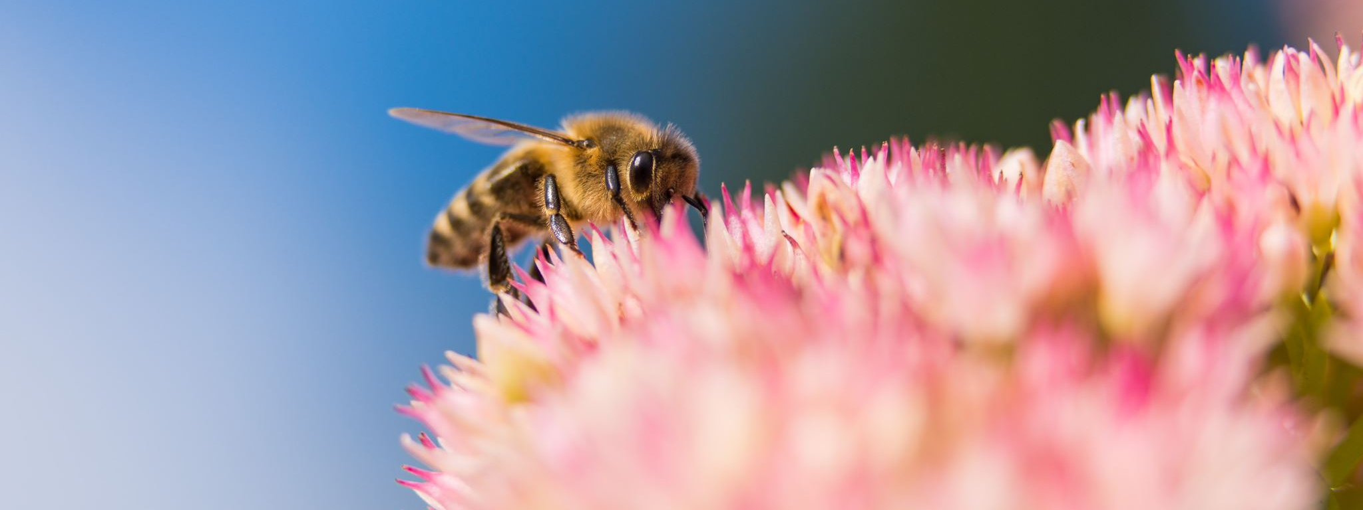
Bees love native thyme

Slide 4
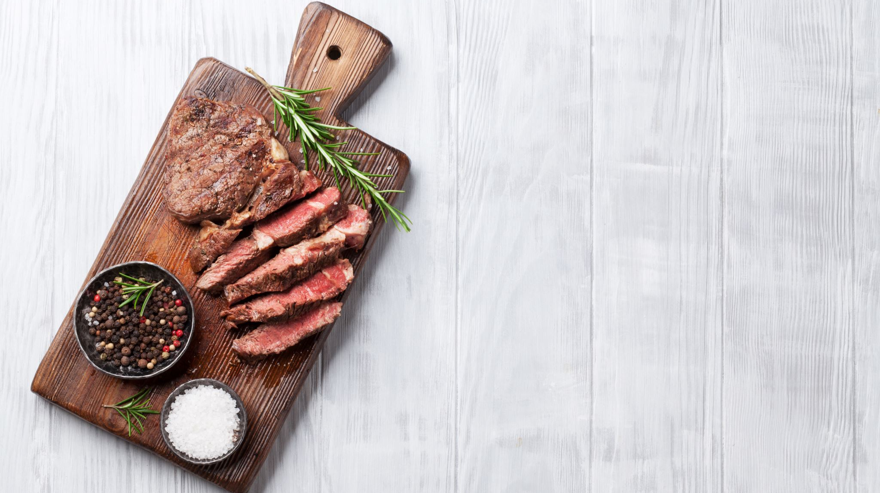
1.5 kg boned lamb leg cut into 6 large pieces 1 tbsp Macadamia Nut Oil 1 tbsp fresh Garlic minced 1 tbsp Native Thyme 1 tbsp Lemon Myrtle 1 tbspn Mountain Pepperleaf Salt 2 tbsp melted butter
Roast Lamb with native thyme
Native thyme is a beautiful perennial that grows up to 1.5m tall and wide. Its leaves, which are small and roughly ovate with softly toothed edges, are strongly scented. When crushed, they release a strong minty aroma with earthy and peppery undertones. Masses of mauve cup-shaped flowers almost cover the shrub in spring.
This fast-growing native will last for a good length of time, but generally starts to decline after 6–8 years. It can easily be replaced with new, quick-growing plants or cuttings.
Once established, it is moderately drought-tolerant, but will grow better when watered regularly, especially during hot, dry periods.

